Slide 1
Memory organisation
Unit 8

Slide 2
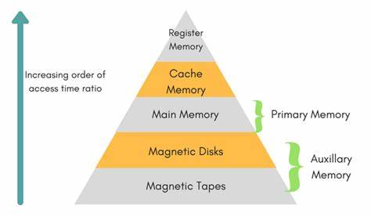
Memory Hierarchy
Memory Hierarchy can be simply illustrated as the organization of the memory for saving the access time. Because of the nicely written codes or program, memory hierarchy works well. It takes less time in accessing at the current level.

Slide 3
Name | Register | Cache | Main Memory | Secondary Memory
Size | <1 KB | less than 16 MB | <16GB | >100 GB
Access Time | 0.25ns to 0.5ns | 0.5 to 25ns | 80ns to 250ns | 50 lakh ns
Managed by | Compiler | Hardware | Operating System | Operating System

Slide 4
1. Registers
Registers are small, high-speed memory units located in the CPU. They are used to store the most frequently used data and instructions. Registers have the fastest access time and the smallest storage capacity, typically ranging from 16 to 64 bits.
2. Cache Memory
Cache memory is a small, fast memory unit located close to the CPU. It stores frequently used data and instructions that have been recently accessed from the main memory. Cache memory is designed to minimize the time it takes to access data by providing the CPU with quick access to frequently used data.
3. Main Memory
Main memory, also known as RAM (Random Access Memory), is the primary memory of a computer system. It has a larger storage capacity than cache memory, but it is slower. Main memory is used to store data and instructions that are currently in use by the CPU.

Slide 5
4. Secondary Storage
Secondary storage, such as hard disk drives (HDD) and solid-state drives (SSD), is a non-volatile memory unit that has a larger storage capacity than main memory. It is used to store data and instructions that are not currently in use by the CPU. Secondary storage has the slowest access time and is typically the least expensive type of memory in the memory hierarchy.
5. Magnetic Disk
Magnetic Disks are simply circular plates that are fabricated with either a metal or a plastic or a magnetized material. The Magnetic disks work at a high speed inside the computer and these are frequently used.
6. Magnetic Tape
Magnetic Tape is simply a magnetic recording device that is covered with a plastic film. It is generally used for the backup of data. In the case of a magnetic tape, the access time for a computer is a little slower and therefore, it requires some amount of time for accessing the strip.

Slide 6
Main Memory
RAM is the main memory.
It has bidirectional data bus that allows the transfer of data either from memory to CPU during a read operation or from CPU to memory during a write operation.
The capacity of the memory is 128 words of eight bits (one byte) per word.
This requires a 7-bit address and an 8-bit bidirectional data bus.

Slide 7
Types of Main Memory
Static RAM: Static RAM stores the binary information in flip flops and information remains valid until power is supplied. It has a faster access time and is used in implementing cache memory.
Dynamic RAM: It stores the binary information as a charge on the capacitor. It requires refreshing circuitry to maintain the charge on the capacitors after a few milliseconds. It contains more memory cells per unit area as compared to SRAM.

Slide 8
ROM
Read-Only Memory (ROM), is a type of electronic storage that comes built in to a device during manufacturing. You’ll find ROM chips in computers and many other types of electronic products; to complete their functions smoothly. ROM chips come built into an external unit – like flash drives and other auxiliary memory devices – or installed into the device’s hardware on a removable chip. Non-volatile memory like ROM remains viable even without a power supply.
ROM stores “firmware,” which is permanent software that’s hard-wired with integrated circuits. The manufacturer fits a specifically designed ROM chip into a device during the building process.

Slide 9
Unlike the non-volatile memory of a hard drive, it’s difficult and time-consuming to rewrite a ROM chip’s memory. In most cases, it’s impossible to alter integrated circuits, which may mean you can’t update more basic forms of read only memory. You may be able to reprogram some modern types of ROM, but only at slow speeds and with special equipment.
Conventional ROM is pre-programmed to suit its intended hardware. One kind of data usually stored in a read only memory chip is the Basic Input-Output System (BIOS).
A device’s BIOS controls the way the device responds to cues from the user at the most fundamental level, such as a computer’s “booting-up” process that occurs when the system powers on.

Slide 10
Types of ROM
ROM: Classic or “mask-programmed” ROM chips contain integrated circuits. A ROM chip sends a current through a specific input-output pathway determined by the location of fuses among the rows and columns on the chip.
The current can only travel along a fuse-enabled pathway and thus can only return via the output the manufacturer chooses. Rewiring is functionally impossible, and so there’s no way to modify these types of ROM chips.

Slide 11
PROM:
Programmable ROM, or PROM, is essentially a blank version of ROM that you can purchase and program once with the help of a special tool called a programmer.
A blank PROM chip allows current to run through all possible pathways; the programmer chooses a pathway for the current by sending a high voltage through the unwanted fuses to “burn” them out.
Static electricity can create the same effect by accident, so PROMs are more vulnerable to damage than conventional ROMs.

Slide 12
EPROM:
Erasable Programmable ROM chips allow you to write and rewrite them many times. These chips feature a quartz window through which a specialized EPROM programmer emits a specific frequency of ultraviolet light.
This light burns out all the tiny charges in the EPROM to reopen its circuits. This exposure effectively renders the chip blank again, after which you can reprogram it according to the same process as a PROM.
EPROM chips will eventually wear out, but they frequently have lifetimes of over 1000 erasures.

Slide 13
EEPROM:
To modify an Electrically Erasable Programmable ROM chip, apply localized electrical fields to erase and rewrite the data.
EEPROMs have several advantages over other types of ROM. Unlike the earlier forms, you can rewrite EEPROM without dedicated equipment, without removing it from the hardware, and in specifically designated increments.

Slide 14
Auxiliary memory
An Auxiliary memory is known as the lowest-cost, highest-capacity and slowest-access storage in a computer system. It is where programs and data are kept for long-term storage or when not in immediate use.
The most common examples of auxiliary memories are magnetic tapes and magnetic disks.

Slide 15
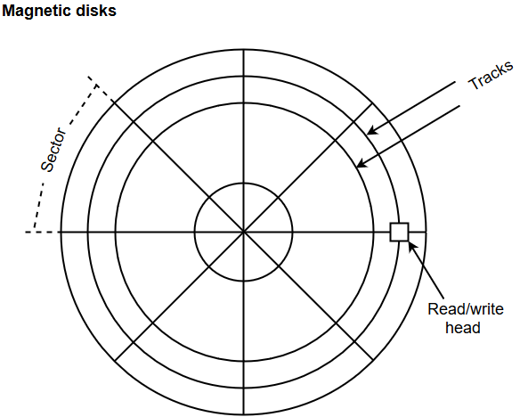
Magnetic Disks
A magnetic disk is a type of memory constructed using a circular plate of metal or plastic coated with magnetized materials. Usually, both sides of the disks are used to carry out read/write operations. However, several disks may be stacked on one spindle with read/write head available on each surface.
The memory bits are stored in the magnetized surface in spots along the concentric circles called tracks.
The concentric circles (tracks) are commonly divided into sections called sectors.

Slide 16
Magnetic Tape
Magnetic tape is a storage medium that allows data archiving, collection, and backup for different kinds of data. The magnetic tape is constructed using a plastic strip coated with a magnetic recording medium.
The bits are recorded as magnetic spots on the tape along several tracks. Usually, seven or nine bits are recorded simultaneously to form a character together with a parity bit.
Magnetic tape units can be halted, started to move forward or in reverse, or can be rewound. However, they cannot be started or stopped fast enough between individual characters. For this reason, information is recorded in blocks referred to as records.

Slide 17
Associative Memory
An associative memory can be considered as a memory unit whose stored data can be identified for access by the content of the data itself rather than by an address or memory location.
Associative memory is often referred to as Content Addressable Memory (CAM).
When a write operation is performed on associative memory, no address or memory location is given to the word. The memory itself is capable of finding an empty unused location to store the word.
On the other hand, when the word is to be read from an associative memory, the content of the word, or part of the word, is specified. The words which match the specified content are located by the memory and are marked for reading.

Slide 18
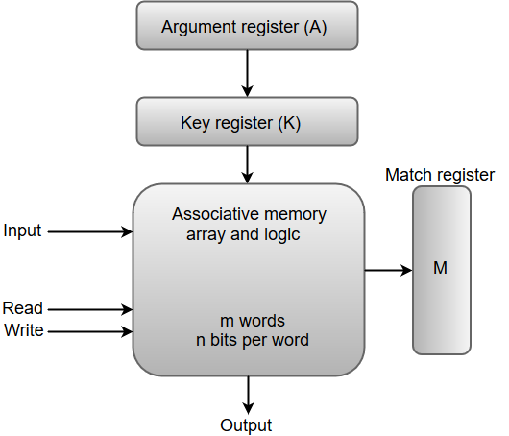
From the block diagram, we can say that an associative memory consists of a memory array and logic for 'm' words with 'n' bits per word.
The functional registers like the argument register A and key register K each have n bits, one for each bit of a word. The match register M consists of m bits, one for each memory word.
The words which are kept in the memory are compared in parallel with the content of the argument register.
The key register (K) provides a mask for choosing a particular field or key in the argument word. If the key register contains a binary value of all 1's, then the entire argument is compared with each memory word. Otherwise, only those bits in the argument that have 1's in their corresponding position of the key register are compared. Thus, the key provides a mask for identifying a piece of information which specifies how the reference to memory is made.
The following diagram can represent the relation between the memory array and the external registers in an associative memory.

Slide 19
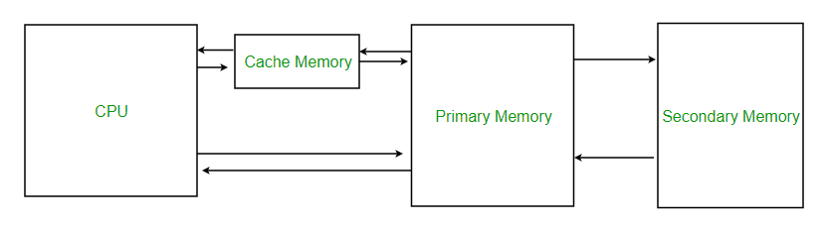
Cache Memory
Cache Memory is a special very high-speed memory. The cache is a smaller and faster memory that stores copies of the data from frequently used main memory locations.
There are various different independent caches in a CPU, which store instructions and data. The most important use of cache memory is that it is used to reduce the average time to access data from the main memory.

Slide 20
Locality of Reference
Locality of reference refers to a phenomenon in which a computer program tends to access same set of memory locations for a particular time period.
In other words, Locality of Reference refers to the tendency of the computer program to access instructions whose addresses are near one another.

Slide 21
Cache Performance: (Hit and Miss Ratio)
The performance of the cache is measured in terms of hit ratio. When CPU refers to memory and find the data or instruction within the Cache Memory, it is known as cache hit.
If the desired data or instruction is not found in the cache memory and CPU refers to the main memory to find that data or instruction, it is known as a cache miss.
Hit + Miss = Total CPU Reference
Hit Ratio(h) = Hit / (Hit+Miss)
Miss Ratio = 1 - Hit Ratio(h)
Miss Ratio = Miss / (Hit+Miss)

Slide 22
To calculate a hit ratio, divide the number of cache hits with the sum of the number of cache hits, and the number of cache misses.
For example, if you have 51 cache hits and three misses over a period of time, then that would mean you would divide 51 by 54. The result would be a hit ratio of 0.944.
You can also choose to express this as a percentage by multiplying the end result by 100.
In the example above, the 0.944 result would be multiplied by 100 to get a hit ratio of 94.4%.
Alternatively, you can find out the hit ratio if you already know the miss ratio. Then, you can subtract one by the miss ratio.
You can do this because the hit and miss ratios equal to one.

Slide 23
How to Calculate a Miss Ratio
You can also calculate a miss ratio by dividing the number of misses with the total number of content requests.
For example, if you look over a period of time and find that the misses your cache experienced was11, and the total number of content requests was 48, you would divide 11 by 48 to get a miss ratio of 0.229.
Similar to hit ratios, you can also calculate a miss ratio if you already know the hit ratio. In that case, you can calculate it by subtracting one from the hit ratio.

Slide 24
Cache Mapping
There are three different types of mapping used for the purpose of cache memory which is as follows:
Direct Mapping
Associative Mapping
Set-Associative Mapping

Slide 25
1. Direct Mapping
The simplest technique, known as direct mapping, maps each block of main memory into only one possible cache line or In Direct mapping, assign each memory block to a specific line in the cache.
If a line is previously taken up by a memory block when a new block needs to be loaded, the old block is trashed.
An address space is split into two parts index field and a tag field. The cache is used to store the tag field whereas the rest is stored in the main memory. Direct mapping`s performance is directly proportional to the Hit ratio.

Slide 26
2. Associative Mapping
In this type of mapping, associative memory is used to store the content and addresses of the memory word.
Any block can go into any line of the cache. This means that the word id bits are used to identify which word in the block is needed, but the tag becomes all of the remaining bits.
This enables the placement of any word at any place in the cache memory. It is considered to be the fastest and most flexible mapping form. In associative mapping, the index bits are zero.

Slide 27
3. Set-Associative Mapping
This form of mapping is an enhanced form of direct mapping where the drawbacks of direct mapping are removed.
Set associative addresses the problem of possible thrashing in the direct mapping method. It does this by saying that instead of having exactly one line that a block can map to in the cache, we will group a few lines together creating a set.
Then a block in memory can map to any one of the lines of a specific set. Set-associative mapping allows each word that is present in the cache can have two or more words in the main memory for the same index address.
Set associative cache mapping combines the best of direct and associative cache mapping techniques.
In set associative mapping the index bits are given by the set offset bits. In this case, the cache consists of a number of sets, each of which consists of a number of lines

Slide 28
Virtual Memory
Virtual memory, or virtual storage, is a memory management technique employed by computer systems to optimize the utilization of physical storage. In simple terms, when the computer is low on physical memory – the RAM chips you plug in to your computer – it temporarily uses space on the hard drive or solid state drive to store and swap information back and forth from the physical RAM as needed, in order to keep the computer working as efficiently as possible.
Without virtual memory, the computer would be unable to keep working when it filled the available RAM.
Virtual memory management was helpful when SSDs were expensive, because this could reduce costs, or when spinning hard disks were being used for storage, because these were extremely slow compared to RAM.

Slide 29
Virtual memory can give programmers the deception that they have a very high memory although the computer has a small main memory. It creates the function of programming easier because the programmer no longer requires to worry about the multiple physical memory available.

Slide 30
There are two primary methods for implementing virtual memory are as follows:
Paging is a technique of memory management where small fixed-length pages are allocated instead of a single large variable-length contiguous block in the case of the dynamic allocation technique. In a paged system, each process is divided into several fixed-size ‘chunks’ called pages, typically 4k bytes in length. The memory space is also divided into blocks of the equal size known as frames.

Slide 31
Segmentation
The partition of memory into logical units called segments, according to the user’s perspective is called segmentation. Segmentation allows each segment to grow independently, and share. In other words, segmentation is a technique that partition memory into logically related units called a segment. It means that the program is a collection of the segment.
Unlike pages, segments can vary in size. This requires the MMU to manage segmented memory somewhat differently than it would manage paged memory. A segmented MMU contains a segment table to maintain track of the segments resident in memory.
A segment can initiate at one of several addresses and can be of any size, each segment table entry should contain the start address and segment size.

